Slide 1
How Typeform's D&A team managed to embed its Data Scientists into cross-functional teams while maintaining their cohesion
Viola Melis
Data Scientist
David Martín Borregón
Lead Data Scientist

Slide 2
Barcelona based startup
Online data collection tool
Making forms more human

Slide 3
Barcelona based startup
Online data collection tool
Making forms more human

Slide 4
Story of a fast growth

Slide 5
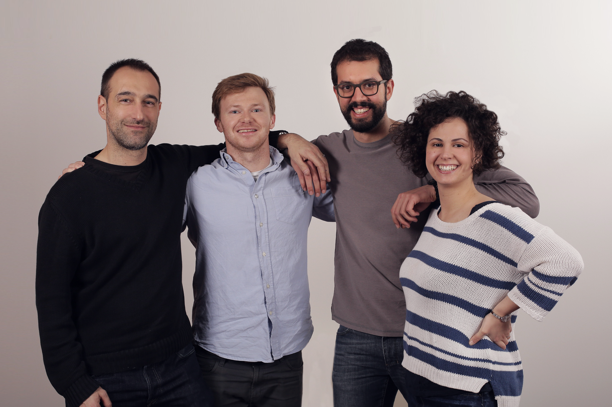
Two years ago
Small D&A team.
Acting as a Service Department.
Typeform counted around 80 employees.

Slide 6
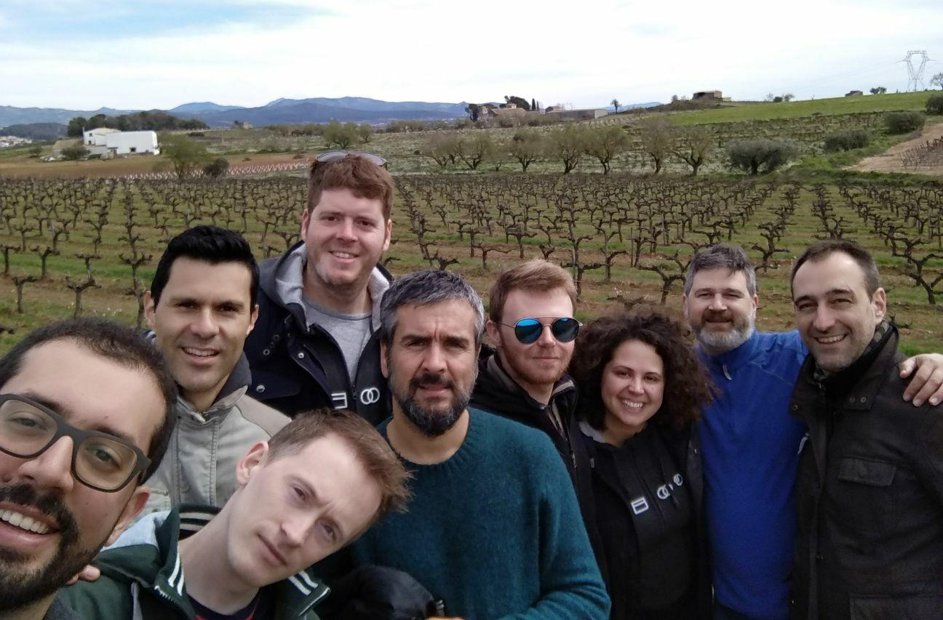
Jumping to now
Typeform has around 190 employees.
The Data team counts 15 people across different roles.

Slide 7
Today's Typeform's Data & Analytics Team
Data Warehouse
Aka Unique Source of Truth
Data Operation
Data Science
Data Engineering
Tracking Definition
Dashboards
Decision Support
Analytics
Machine Learning

Slide 8
The role
of the Data Scientists
From being part of a Service Department…
...To being embedded in most cross-functional teams.

Slide 9
Service department
Customer Success
Marketing
Design
Finance
Product
HR
Data Science

Slide 10
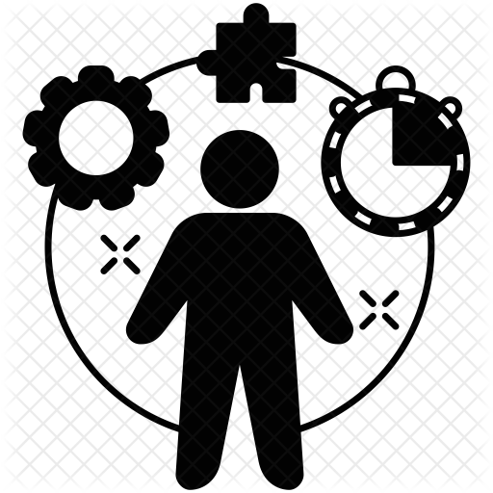
Cross functional teams
Developers
Customer Success
Designer
Marketing
Product Owner
Finance
QA
Engineer
Data
Scientist
Data
Scientist

Slide 11
The role
of the Data Scientists
From reactive…
… to proactive

Slide 12
Proactive
Data Scientists
Are able to exploit their full problem-solving potential.
Proactively look for opportunities.
Influence the Product roadmap.
Better timing for solutions.

Slide 13
Proactive
Data Scientists
Data Informed Decision Making

Slide 14
What about the possible drawbacks?
Isolation
Misalignment
Lack of an holistic view

Slide 15
What about the possible drawbacks?
Inefficient and demotivated team.

Slide 16
Overview of the talk
General learnings.
Deep dive into the initiatives.

Slide 17
Learning #1:
Build a centralised
team first.
It will make it easy and natural for the data scientists to collaborate.
They will gain a holistic understanding of the Business.

Slide 18
Learning #2:
Be flexible.
Learning #1:
Timing is important.

Slide 19
Learning #3:
Empower the Data Scientists.
Involve them in the decision since the early stages.
They should be responsible to find the best ways to maintain their cohesion.

Slide 20
Recap
Build a centralised team first.
Be flexible.
Empower the Data Scientists.
Now… What initiatives did we consider?

Slide 21
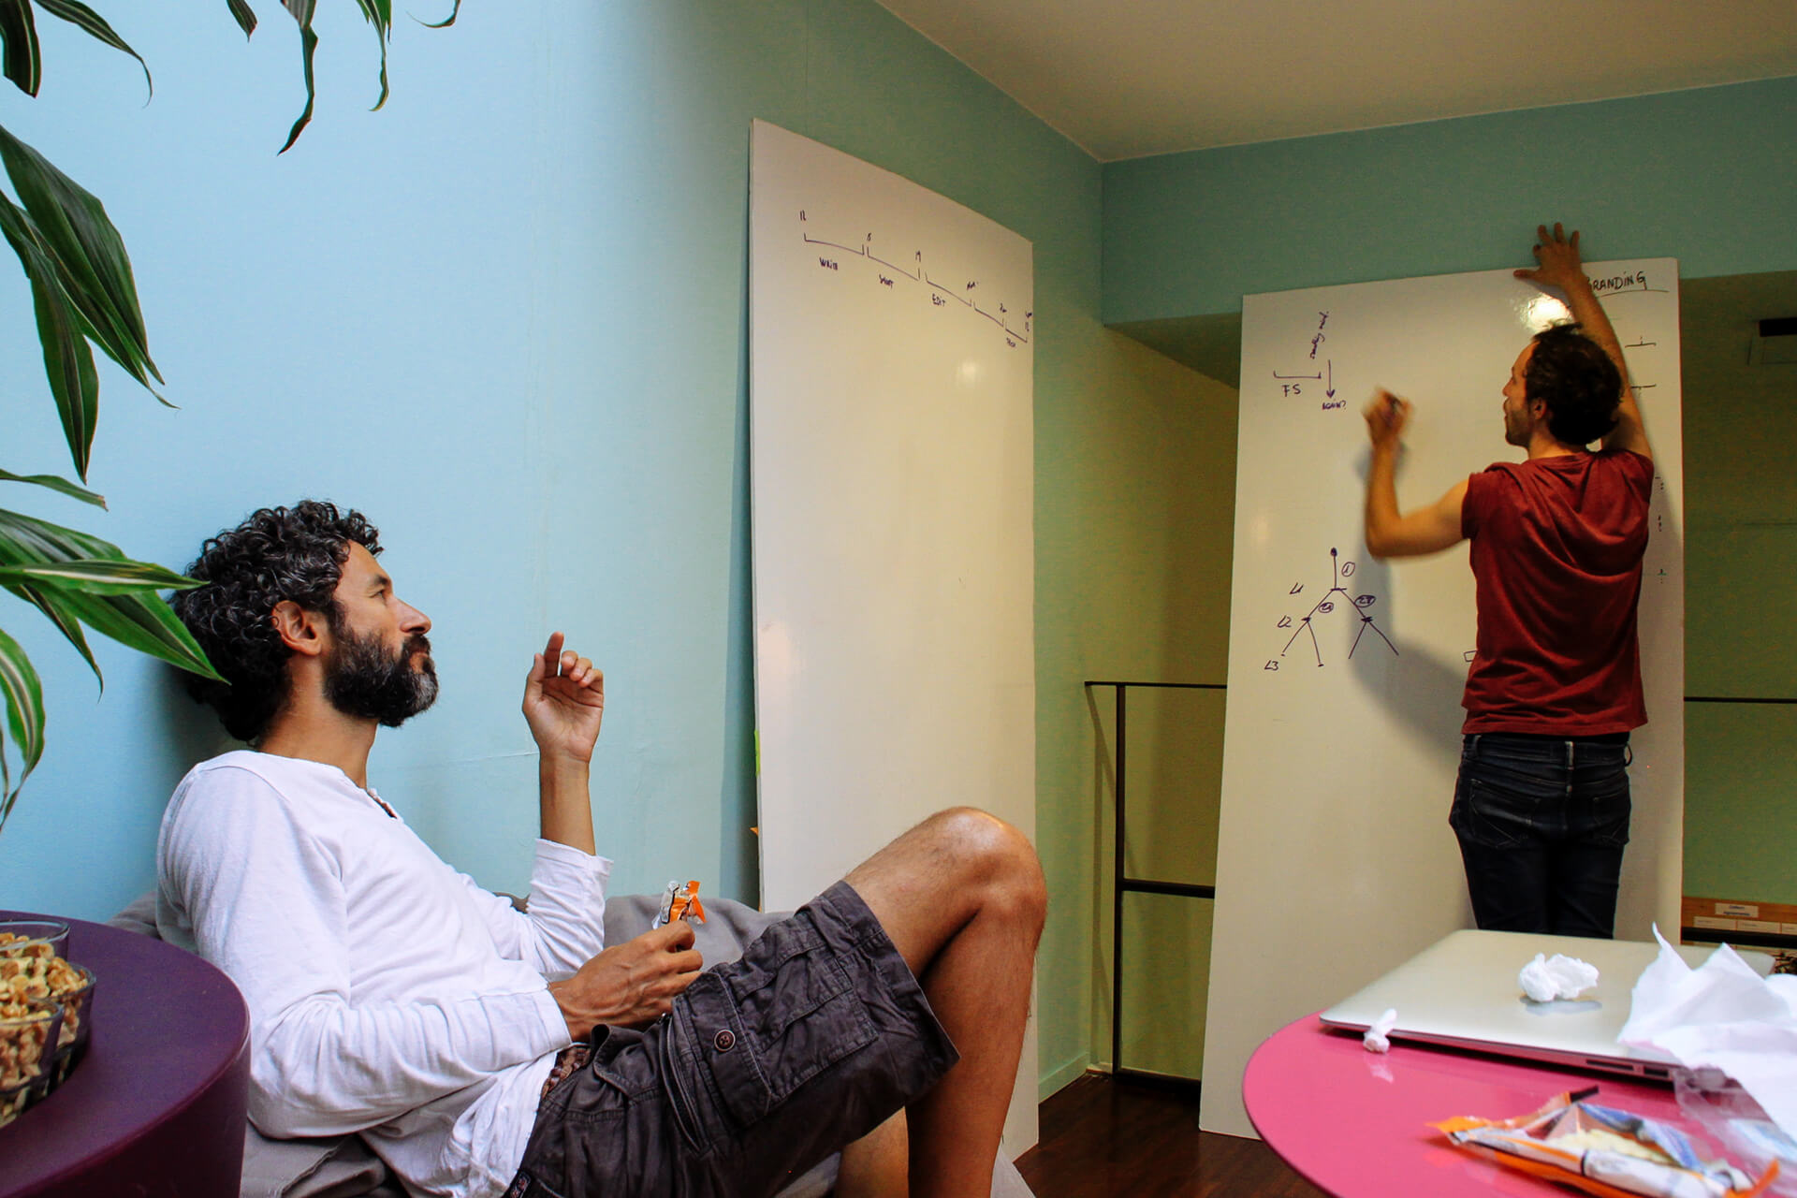
#1: Brainstormings
Fast way to investigate solutions for complex problems.
Max 2 to 4 participants.

Slide 22
#2: Daily standups
Everyone answers the questions:
What have I accomplished yesterday?
What will I do today?
Is there any blocker toward accomplishing my objectives?

Slide 23
#3: Daily standups
Keep it short: 10 to 15 minutes max.
If you need to get more into detail, do so after the daily.
The entire D&A Team (Data Ops + Data Science) participate.

Slide 24
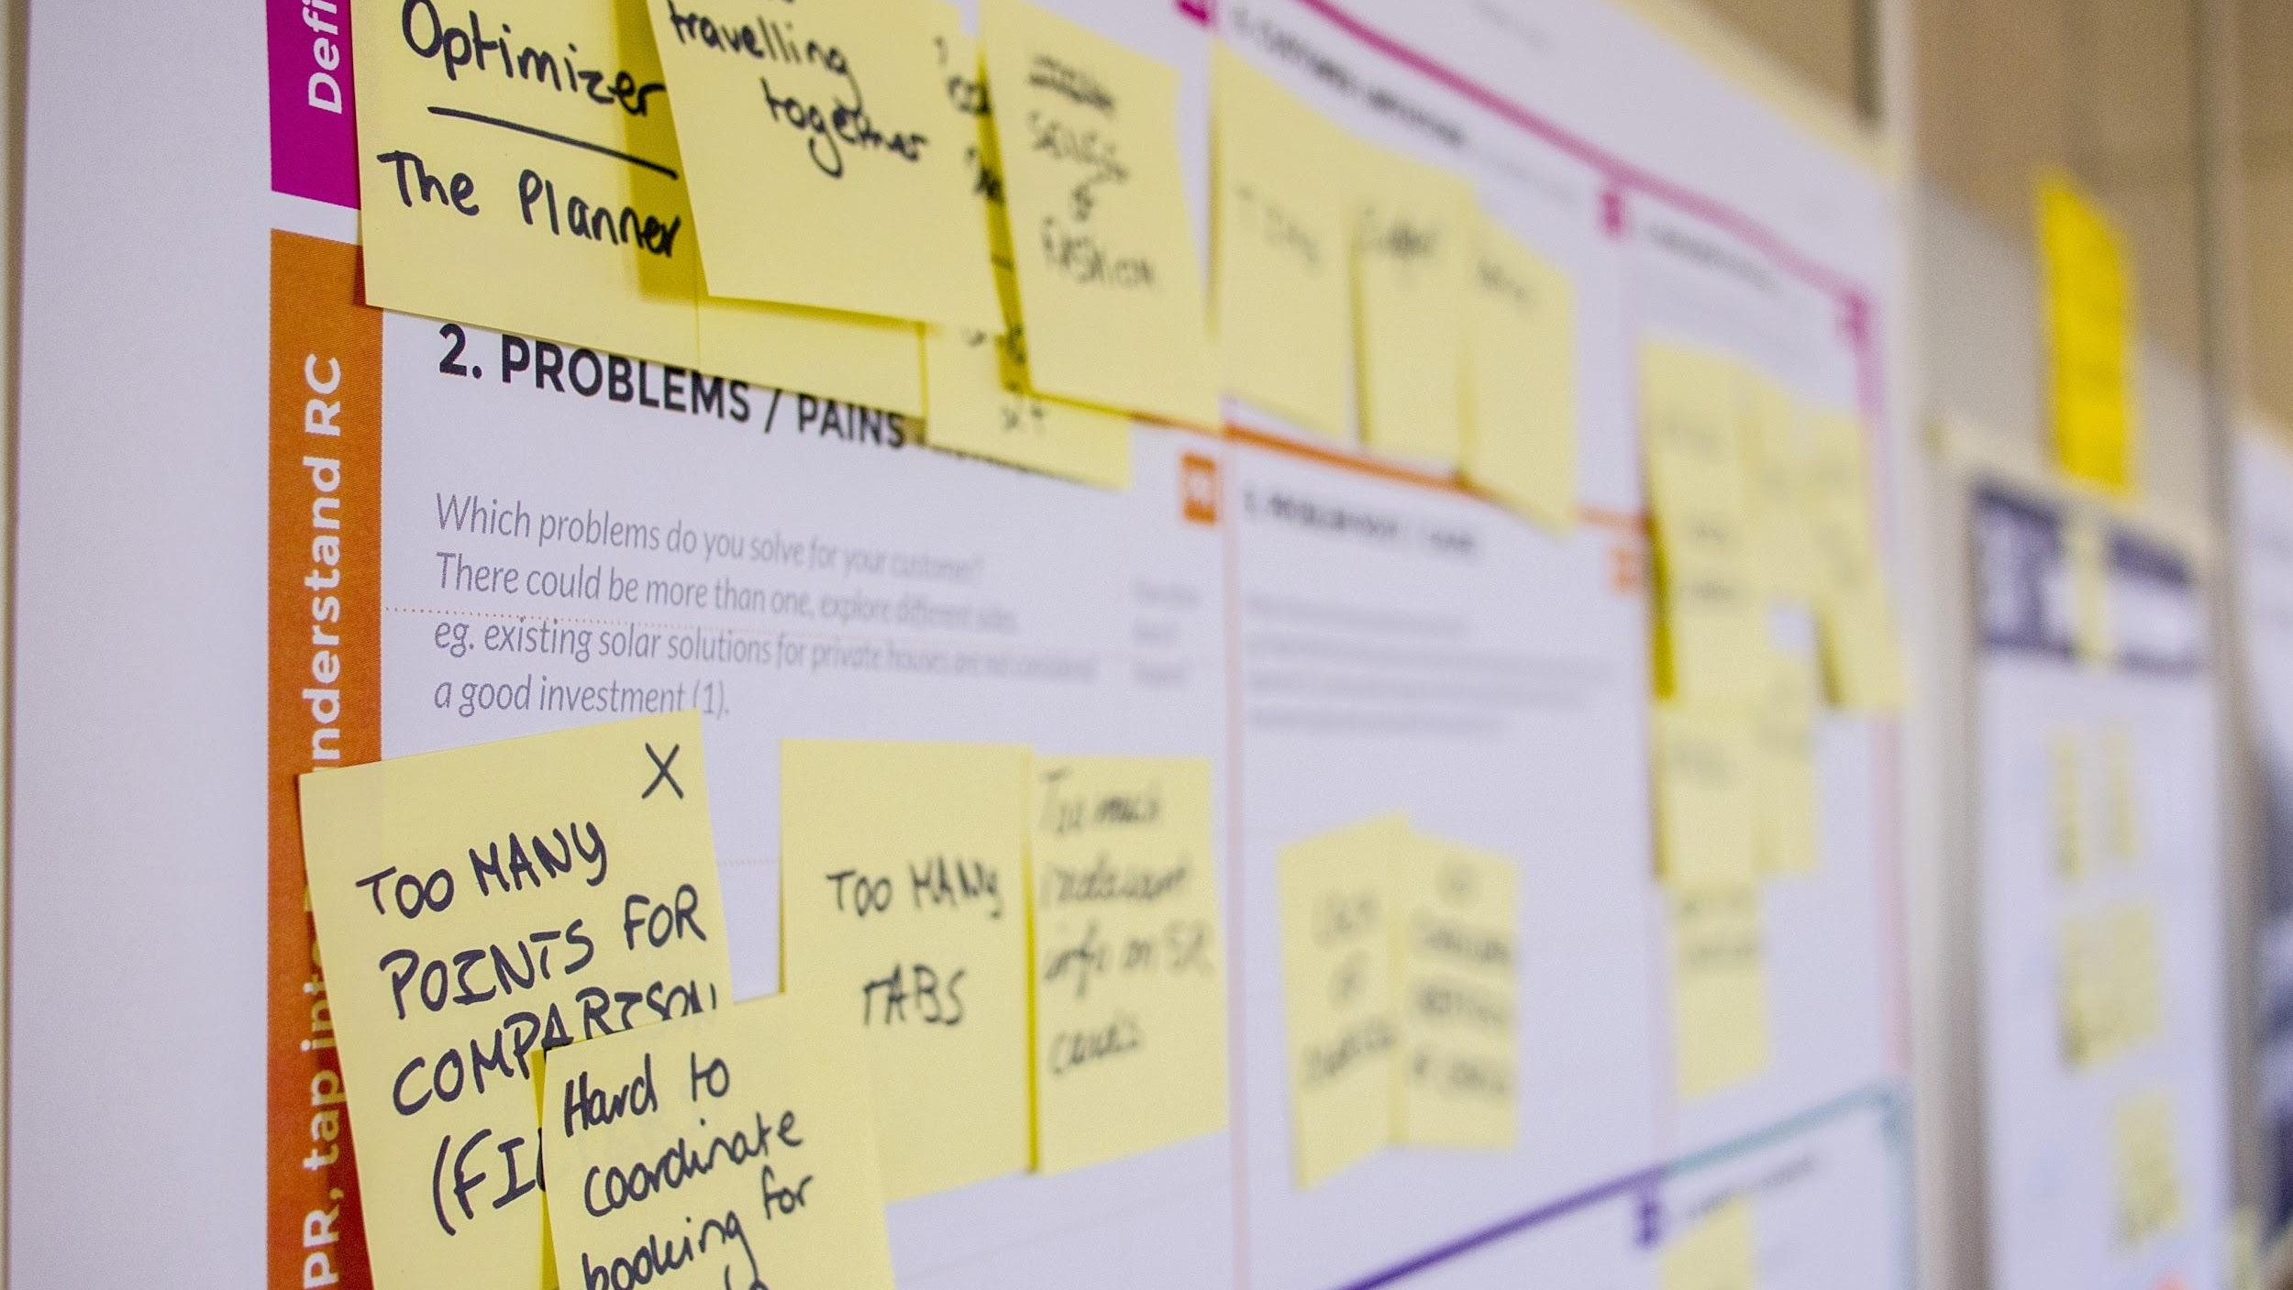
#4: Retrospectives
Topics are varied but should never be at personal level.
Always and with action points and an owner for each action.
The entire D&A Team (Data Ops + Data Science) participate.

Slide 25
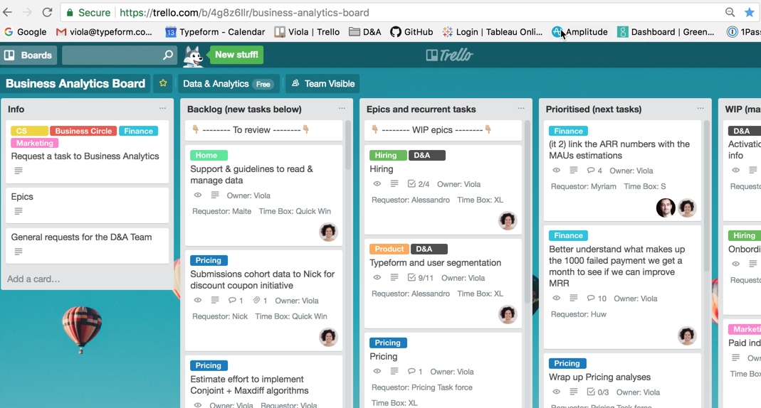
#5: Task Prioritisation
Kanban methodology:
Stop starting, start finishing.
Continuous delivery flow.
Limit WIP.
Data scientists are able to propose new tasks.
Data scientists are able to prioritise their own backlog.

Slide 26
#6: Sharing is Caring
Weekly meeting opened to all data scientists.
Share analyses' results.
Ask for feedback.
Share other team's updates.
Decide on common matters.

Slide 27
#7: Code sharing
Keep your code available for everybody to review.
Establish standards to share the results.

Slide 28
#8: Mob Programming
(and Mob Dashboarding)
Same project, same space, same laptop.
Better quality results.
Knowledge sharing environment.

Slide 29
Quick recap.

Slide 30
Thanks
viola@typeform.com
david.martin@typeform.com

